Slide 1
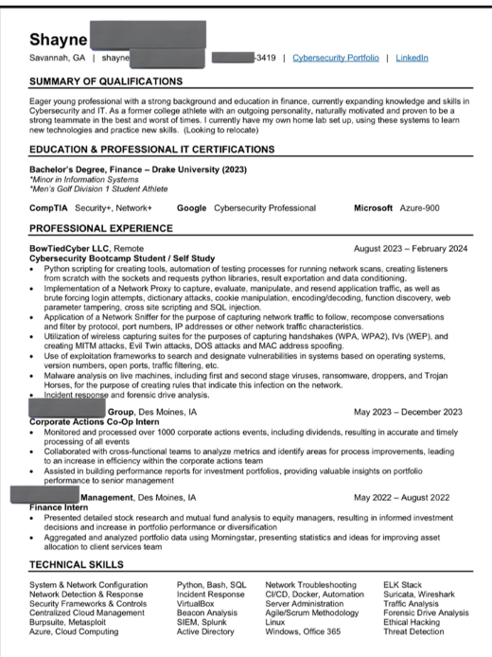
jeariaas@gmail.com | github.com/jearias | linkedin.com/in/arias-jesus/ | 480-939-1780
Jesus Arias
Summary of Qualifications
Aspiring young professional with a developing background and strong education in software and hardware engineering. As a former leader in Engineer Student Council and Design Team lead, I naturally learn, listen, and reflect to support those around me and myself. I am currently working on a myriad of projects such as data structure and algorithms self-study, building custom mechanical keyboards, and learning new skills in automobile repair and mechanical engineering.
Education
The University of Arizona – W.A. Franke Honors College
B.S. - Electrical Engineering and Computer Engineering
Minor - Mathematics
May 2023
GPA: 3.53
Professional Experience
Chandler, AZ
June 2021 – June 2023
Hardware Computer/Reliability Engineer
Microchip Technology Inc.
Developed a Python automation script to parse and calculate MTBFIT data from quarterly Reliability Monitoring Reports: featuring directory file selection, precise data separation and requisition, streamlined JSON conversion for efficient storage, and automatic file creation timestamping.
Managed advanced technologies: ELES Smart, ELES TTS1, MCC-LC2, and AEHR Max2/Max3 ovens, enhancing operational performance.
Led reliability testing for 5 product lines, ensuring robust quality standards with tests like DLT and HAST.
Researched and submitted 30+ Burn-In Spec product qualification reports, demonstrating meticulous attention to detail.
Created an AEHR to MCC-LC2 burn-in program conversion, improving workflow efficiency and cross-platform compatibility.
Software Engineering Intern
IBM Corporation
Developed diagnostic health evaluation script deployed to over 4000 XIV/A9000/R. flash storage systems to identify potential failing BBU power supplies.
Implemented Linux script which negated the need for physical BBU power supply replacement for over 10,000 servers worldwide.
Diagnosed technical issues related to the XIV/A9000/R flash storage system server.
Tucson, AZ
June 2021 – June 2023
Projects
Tucson, AZ
August 2022 – May 2023
Senior Design Project - Software and Hardware Design Team Lead
University of Arizona & Microsoft Corporation
Prototyped and constructed a Two-Phase Immersion Cooling server for Microsoft using FC-72 Fluorinert.
Designed and coded a GUI in Python for system and sensor control.
Integrated a dynamically updating multi-axis graph in C++ and Python from data from sensor input
Directed total system wiring, total system design and construction.
Received Best Design Popular Vote during Craig M. Berge Senior Capstone Design Day

Slide 2
